Slide 1


Digital Fundraising:
Unlocking the Potential of Online Giving
DS-670 Capstone
Assignment 3 Presentation
By Kristopher Albano

Slide 2

AGENDA
Updates
ML: Random Forest
ML: XGBoost
ML: KMeans Clustering - PCA
ML: Time-series – ARIMA/ ES

Slide 3

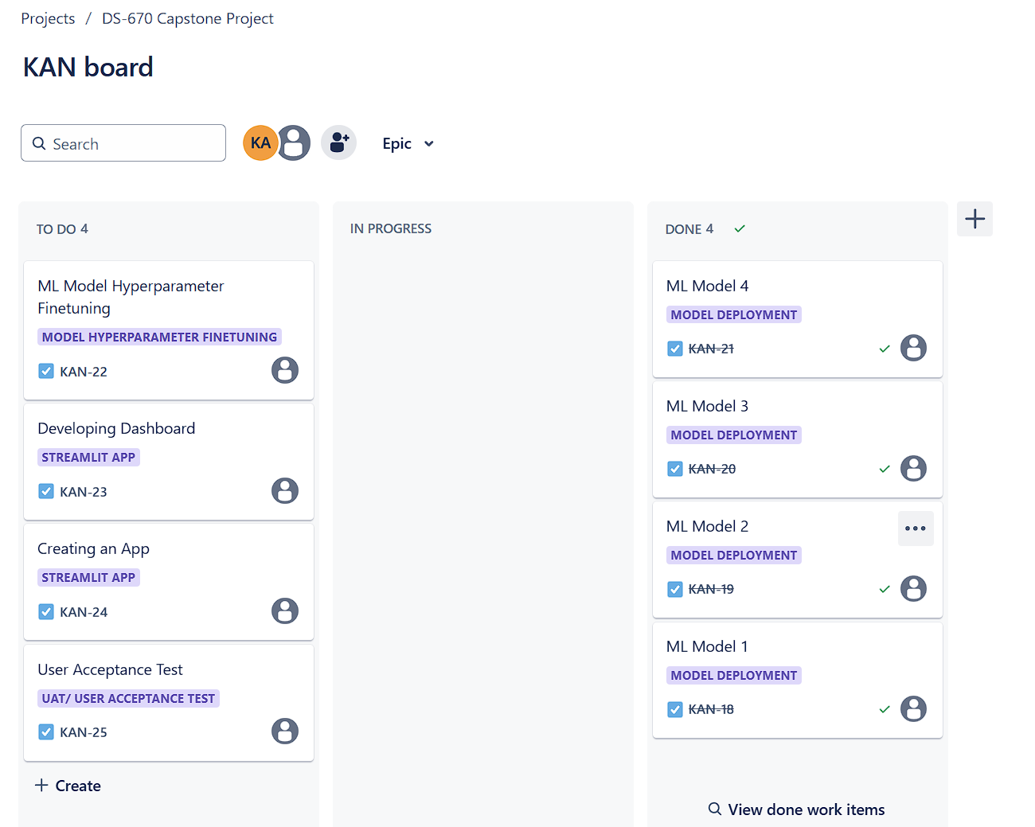

Updates - JIRA

Slide 4
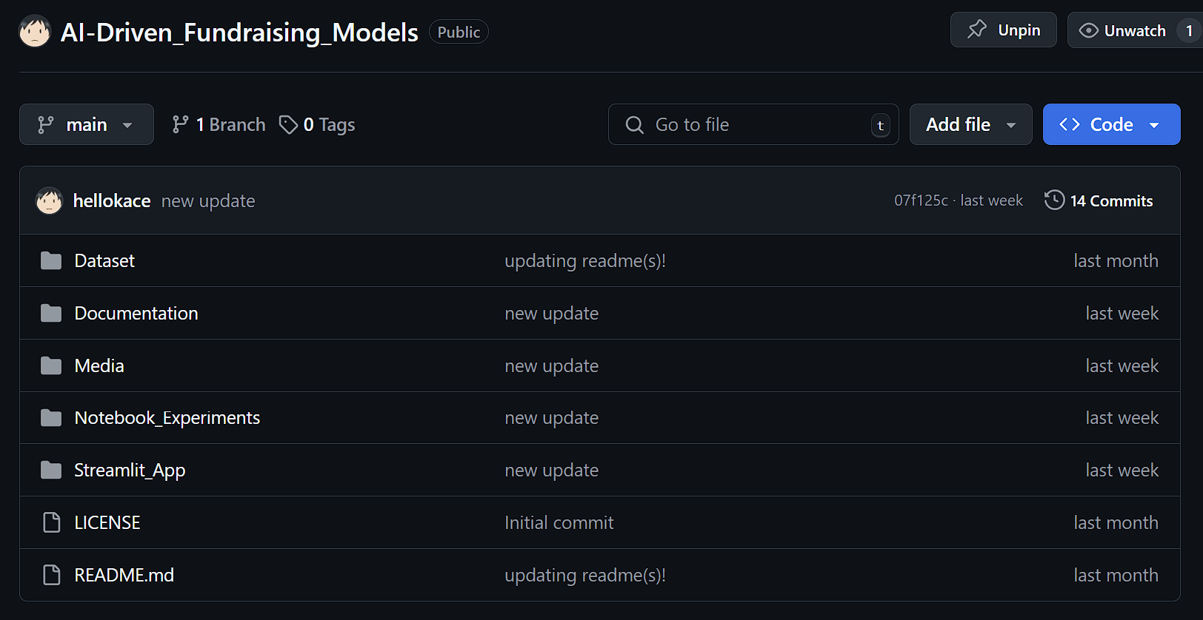
Updates - GitHub

Slide 5

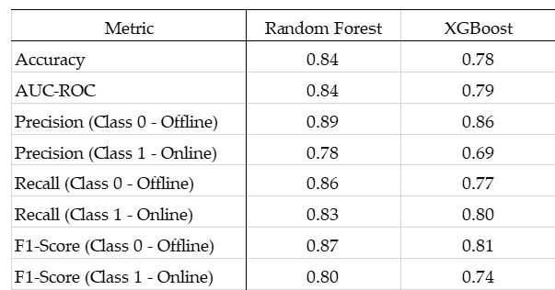
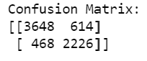
ML: Random Forest and XGBoost
Random Forest performed better than XGBoost in all aspects
Aligns with the results of the EDA where there is distinction between online and offline giving
Both models’ performance suggest offline giving is more consistent and predictable

Slide 6



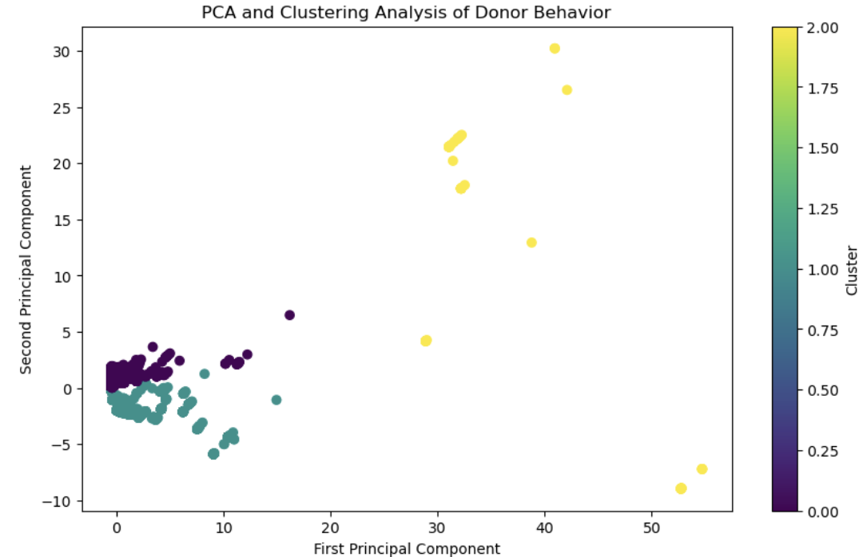
ML: KMeans Clustering - PCA
Purple cluster which represents typical donors
Blue-green cluster which represents transitional donors
Yellow cluster which represents outliers

Slide 7

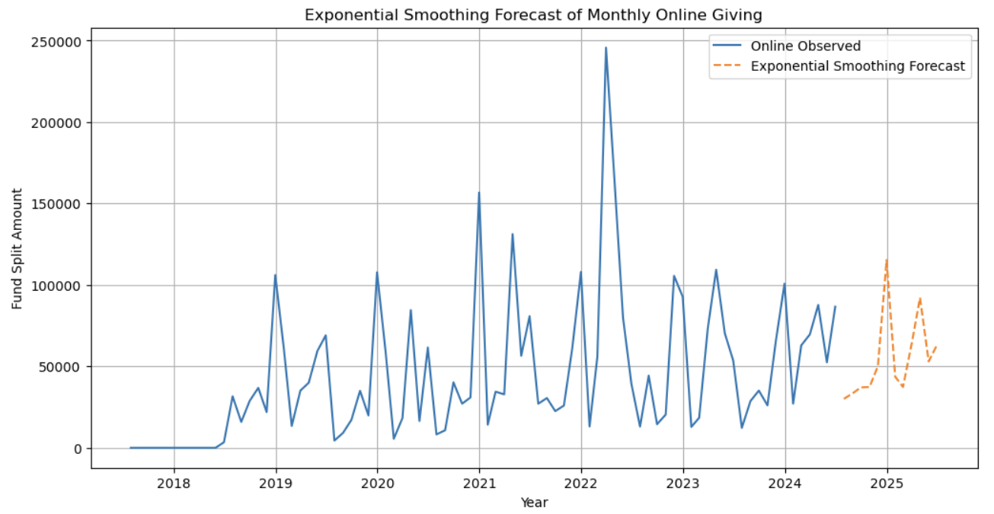
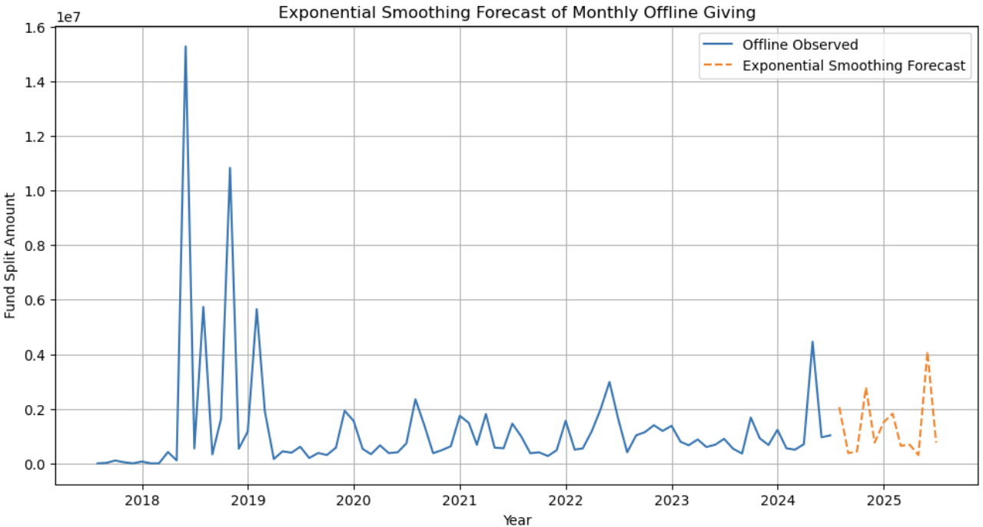

ML: Time-series Analysis
Exponential Smoothing
Highlights the volatility and probably, the seasonality in the online giving plot
The forecasts in both plots follows the trend that is seen in previous years

Slide 8
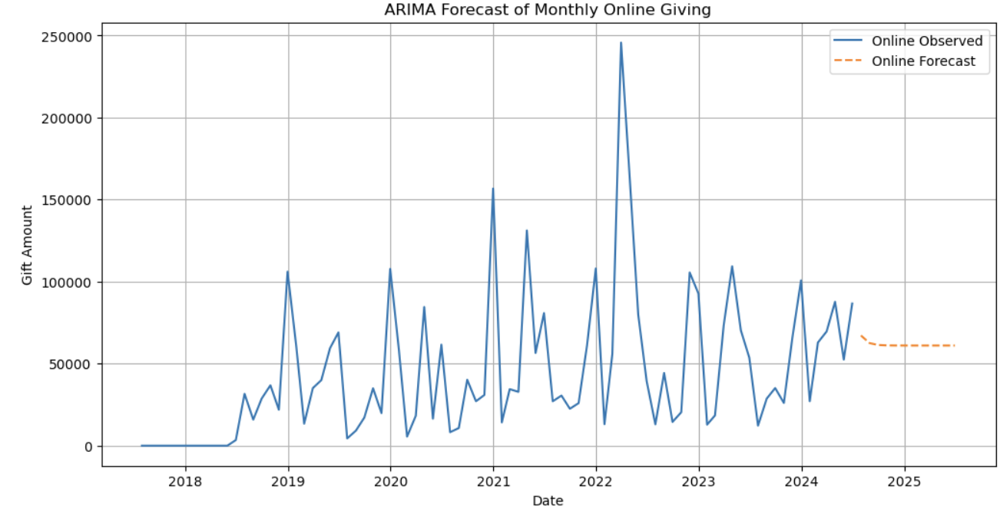
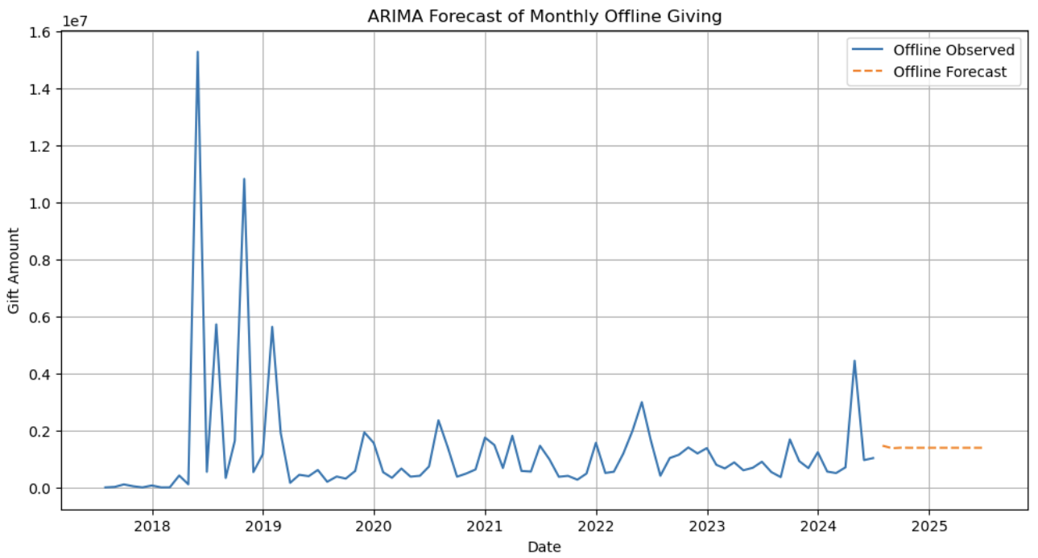
ML: Time-series Analysis
ARIMA
???

Slide 9







Next Actions
Random Forest, being the superior model in predicting online and offline donations, will be used in Hyperparameter Tuning
Get more insights and clarity in the result of the clustering visualization.
Form recommendations based on the results of the time-series data.
Summarize the result of the project.

Slide 10

CREDITS
This presentation template is free for everyone to use thanks to the following:
for the presentation template
Pexels, Pixabay
for the photos
Happy designing!

